Slide 1

Artificial Intelligence
Chris Piech
CSBridge 2019

Slide 2
A Little AI

Slide 3
Something big is happening
in the world of AI…
Notes:
hoy tenemos una mañana muy emocionante

Slide 4
Where is my robot?

Slide 5
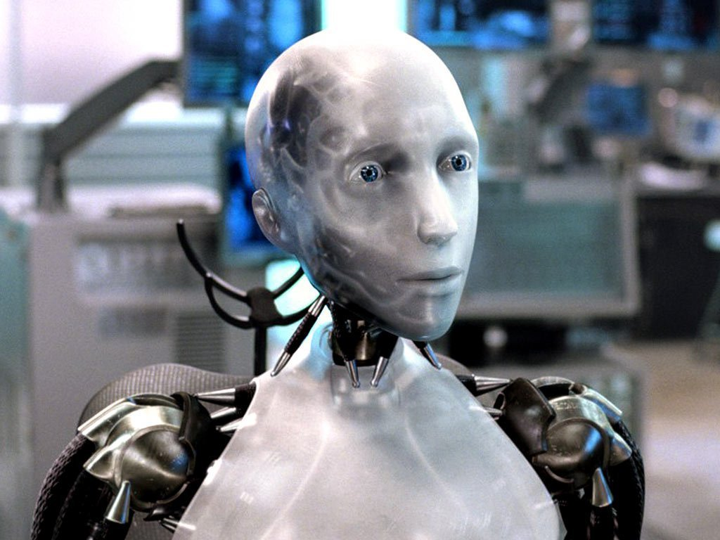
Sci-Fi Has Promised Me Robots

Slide 6
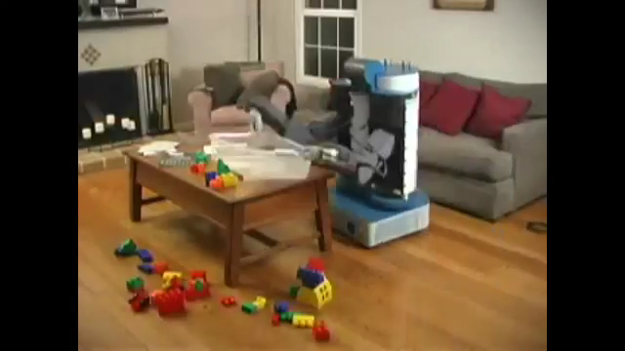
House Cleaning Robot

Slide 7
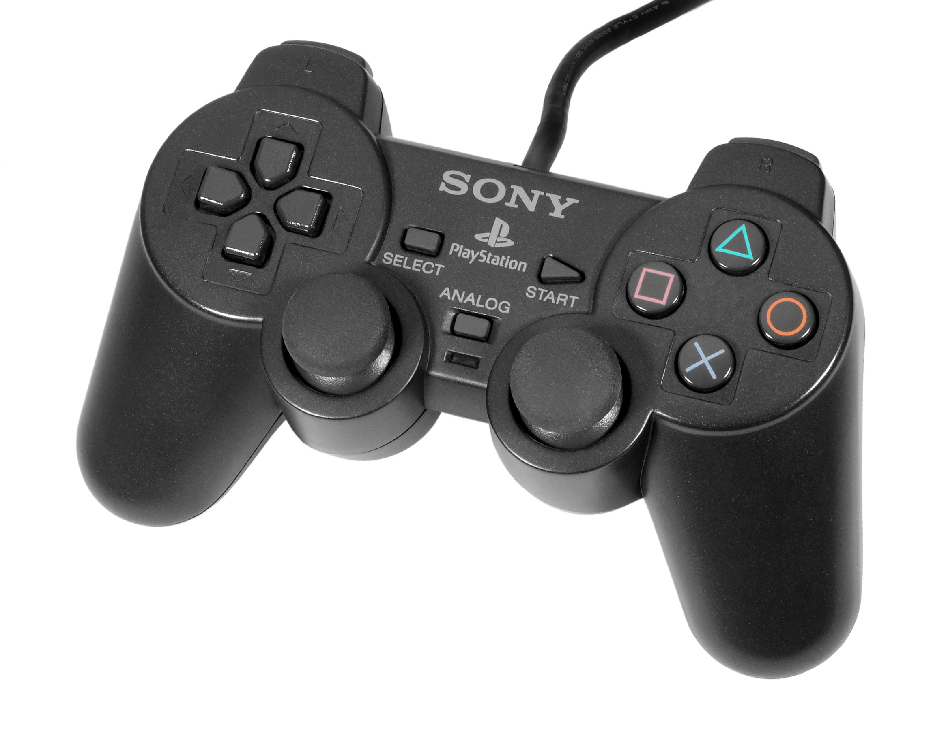
House Cleaning Robot

Slide 8
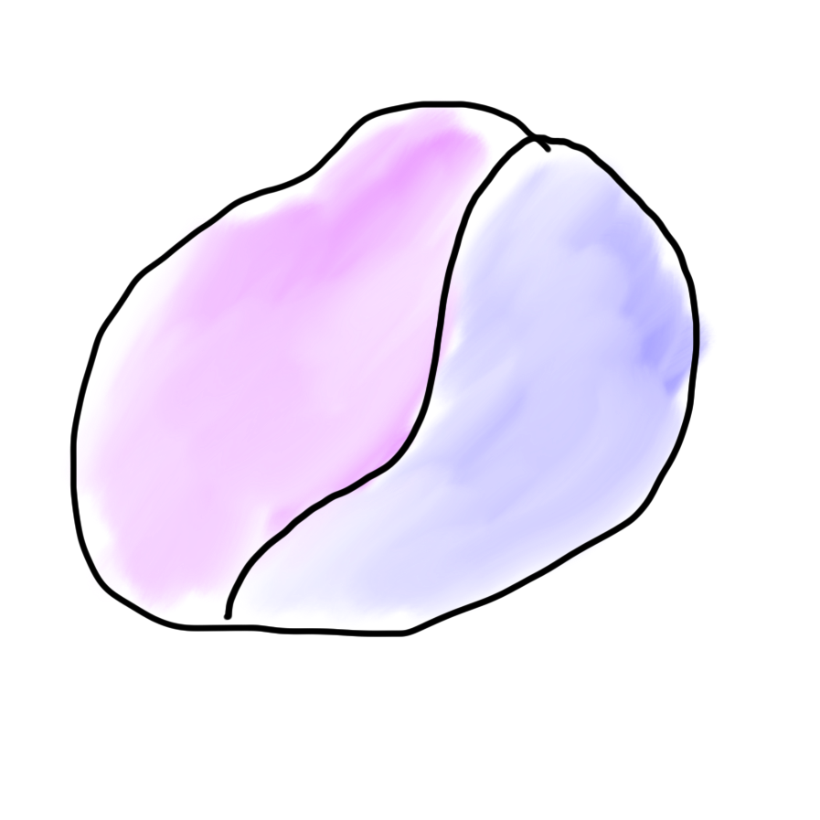
Robots?
Mind
Body

Slide 9

Robots?
Mind
Body

Slide 10
What is AI?

Slide 11
[suspense]

Slide 12
AI: The study and design of intelligent agents

Slide 13

Volunteer

Slide 14
Computer
programs
AI: The study and design of intelligent agents
Better than
chance
As well as
humans

Slide 15
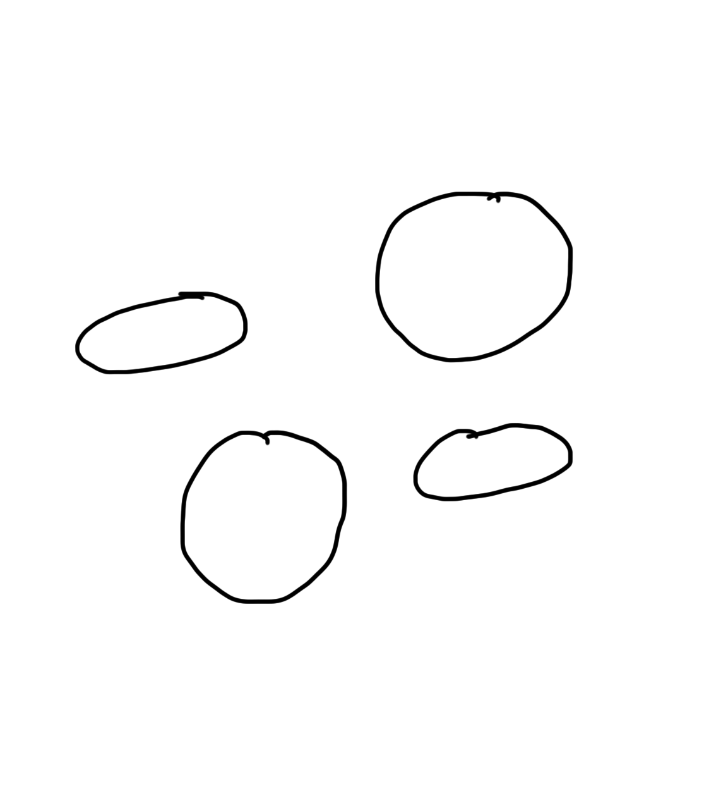
Narrow Intelligence
Translate
Turkish
Play Chess
Play Breakout
Drive a
Car

Slide 16
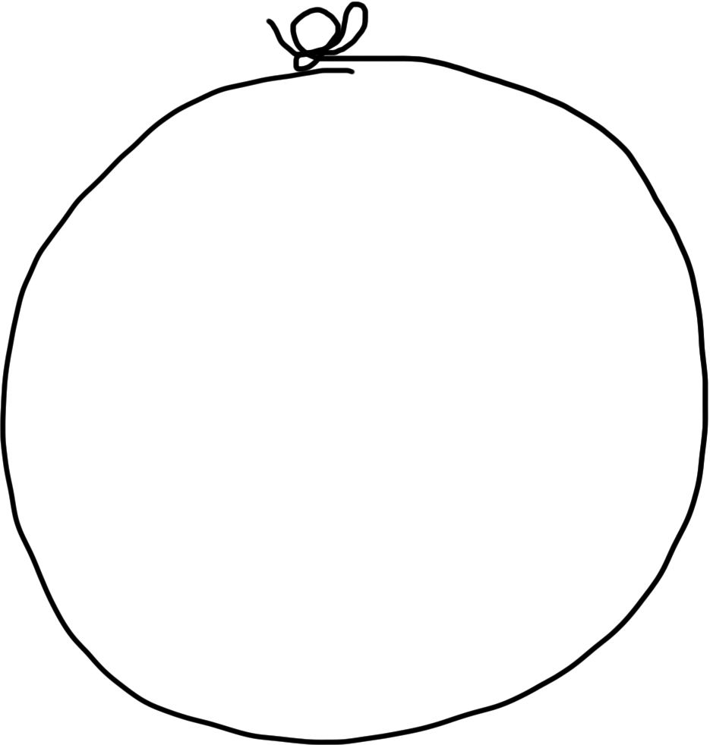
General Intelligence
Translate
Turkish
Play Chess
Play Breakout
Drive a
Car

Slide 17
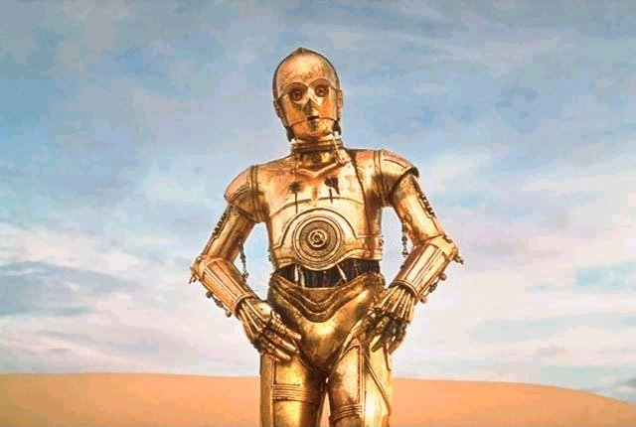
Brief History

Slide 18
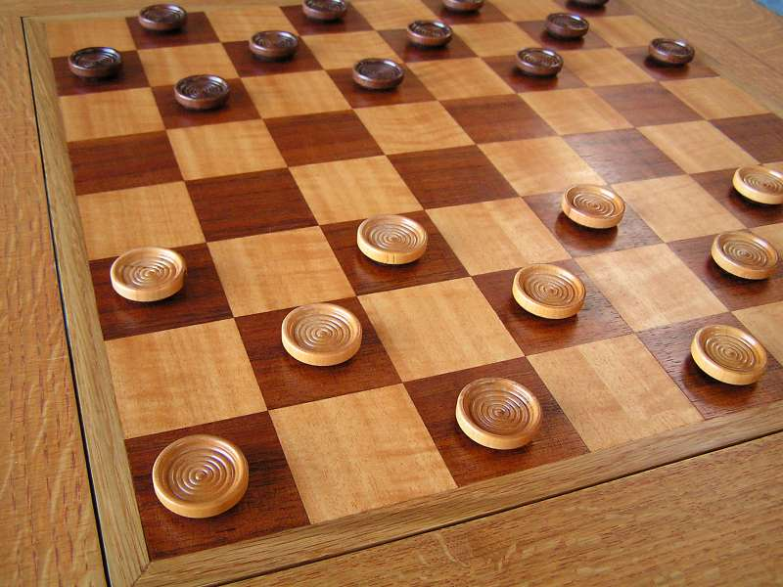
Early Optimism 1950s
1952

Slide 19
Early Optimism 1950s
“Machines will be capable, within twenty years, of doing any work a man can do.”
–Herbert Simon, 1952

Slide 20
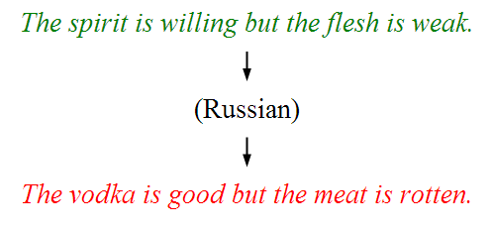
Underwhelming Results 1950s to 1980s
The world is too complex

Slide 21


Slide 22

Big Milestones

Slide 23

Told Speech Was 30 Years Out
Almost perfect…

Slide 24
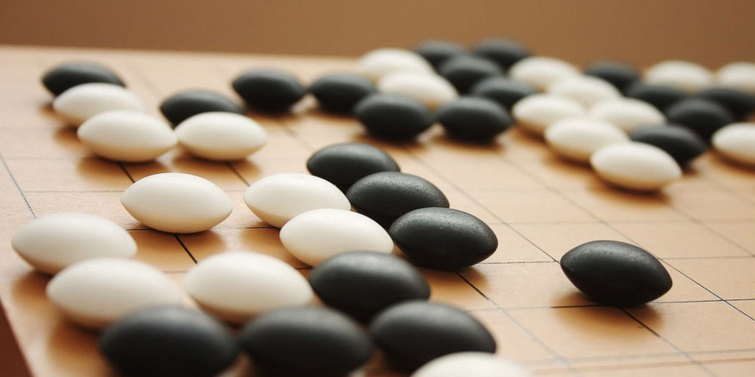
The Last Remaining Board Game

Slide 25
Computers Making Art

Slide 26
Self Driving Cars

Slide 27
What is going on?

Slide 28
[more suspense]

Slide 29
Story of Modern AI

Slide 30
Focus on one problem

Slide 31
Make a Harry Potter Sorting Hat

Slide 32

Classification
Logistic Regression is like the Harry Pottery Sorting Hat
That is a picture
of a one

Slide 33

Classification
Logistic Regression is like the Harry Pottery Sorting Hat
That is a picture
of a zero

Slide 34

Classification
That is a picture
of an zero
* It doesn’t have to be correct all of the time

Slide 35
Can you do it?

Slide 36


Slide 37


Slide 38

How about now?
What a computer sees
0 | 0 | 1 | 0 | 1 | 0 | 1 | 0 | 0 | 0 | 1 | 1 | 1 | 0 | 1
1 | 0 | 0 | 1 | 0 | 1 | 1 | 1 | 0 | 1 | 0 | 0 | 0 | 0 | 0
1 | 1 | 1 | 0 | 1 | 0 | 0 | 1 | 1 | 0 | 0 | 1 | 0 | 1 | 0
1 | 1 | 1 | 1 | 1 | 0 | 0 | 0 | 0 | 0 | 1 | 1 | 0 | 1 | 1
0 | 0 | 0 | 1 | 1 | 0 | 0 | 1 | 0 | 0 | 0 | 1 | 1 | 1 | 0
1 | 0 | 0 | 1 | 1 | 0 | 0 | 0 | 1 | 0 | 1 | 1 | 1 | 1 | 0
1 | 1 | 0 | 1 | 1 | 0 | 0 | 1 | 1 | 0 | 1 | 1 | 1 | 0 | 0
1 | 0 | 1 | 0 | 0 | 1 | 0 | 0 | 1 | 0 | 0 | 1 | 1 | 1 | 1
0 | 0 | 0 | 0 | 1 | 0 | 1 | 0 | 1 | 1 | 0 | 0 | 1 | 1 | 1
0 | 1 | 1 | 0 | 0 | 0 | 0 | 0 | 1 | 1 | 1 | 1 | 1 | 1 | 0
0 | 0 | 1 | 0 | 1 | 1 | 1 | 0 | 0 | 0 | 1 | 0 | 0 | 0 | 0
0 | 1 | 1 | 1 | 0 | 1 | 0 | 0 | 1 | 0 | 0 | 0 | 0 | 0 | 1
1 | 1 | 0 | 0 | 0 | 0 | 0 | 0 | 0 | 0 | 1 | 0 | 0 | 1 | 1
0 | 0 | 0 | 0 | 0 | 0 | 0 | 0 | 1 | 1 | 1 | 1 | 0 | 0 | 1
0 | 0 | 1 | 1 | 1 | 0 | 1 | 0 | 1 | 1 | 0 | 0 | 0 | 1 | 0
What a human sees

Slide 39
Why is it easy for Humans?
About 30% of your cortex is used from vision
3% is used to process hearing

Slide 40
Very hard to Program
??
public class HarryHat extends ConsoleProgram {
public void run() {
println(“Todo: Write program”);
}
}

Slide 41
Perhaps there is an insight?

Slide 42
Two Great Ideas
1. Artificial Neurons
2. Learn by Example

Slide 43
Two Great Ideas
1. Artificial Neurons
2. Learn by Example

Slide 44
1. Artificial Neurons

Slide 45
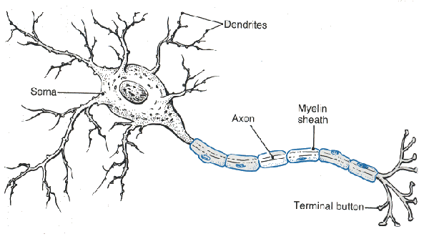
Neuron

Slide 46
Neuron

Slide 47
Neuron

Slide 48
Neuron

Slide 49
Neuron

Slide 50
Some Inputs are More Important

Slide 51
Artificial Neuron

Slide 52

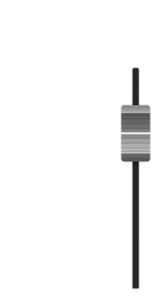

Inputs
+

Slide 53
Inputs
+

Slide 54
Inputs
+

Slide 55
Weights
+

Slide 56
Weights
+

Slide 57
Weights
+

Slide 58
Weighted Sum
+
double weightedSum = 0;
weightedSum = weightedSum + input0 * weight0;
weightedSum = weightedSum + input1 * weight1;
weightedSum = weightedSum + input2 * weight2;
weightedSum = weightedSum + input3 * weight3;

Slide 59
Filter and Output
+

Slide 60
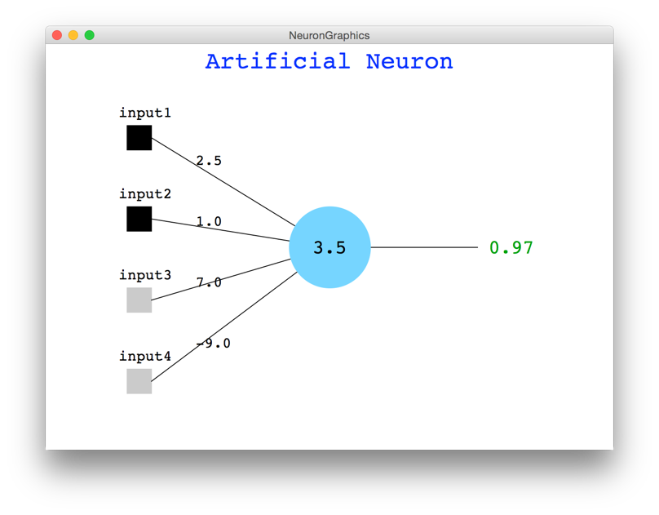
Java Demo

Slide 61
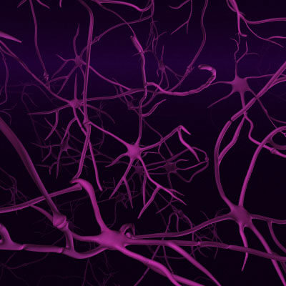
Biological Basis for Neural Networks
A neuron
Your brain
Actually, it’s probably someone else’s brain
???

Slide 62
Put Many Together
+
+
+
+

Slide 63
Put Many Together
Input Neurons
Hidden Neurons
Output Neurons

Slide 64
Making a Prediction
Input Neurons
Hidden Neurons
Output Neurons
…

Slide 65
Making a Prediction
Input Neurons
Hidden Neurons
Output Neurons
…

Slide 66
Making a Prediction
Input Neurons
Hidden Neurons
Output Neurons
…

Slide 67
Making a Prediction
Input Neurons
Hidden Neurons
Output Neurons
I think that is a picture of a one!
…

Slide 68
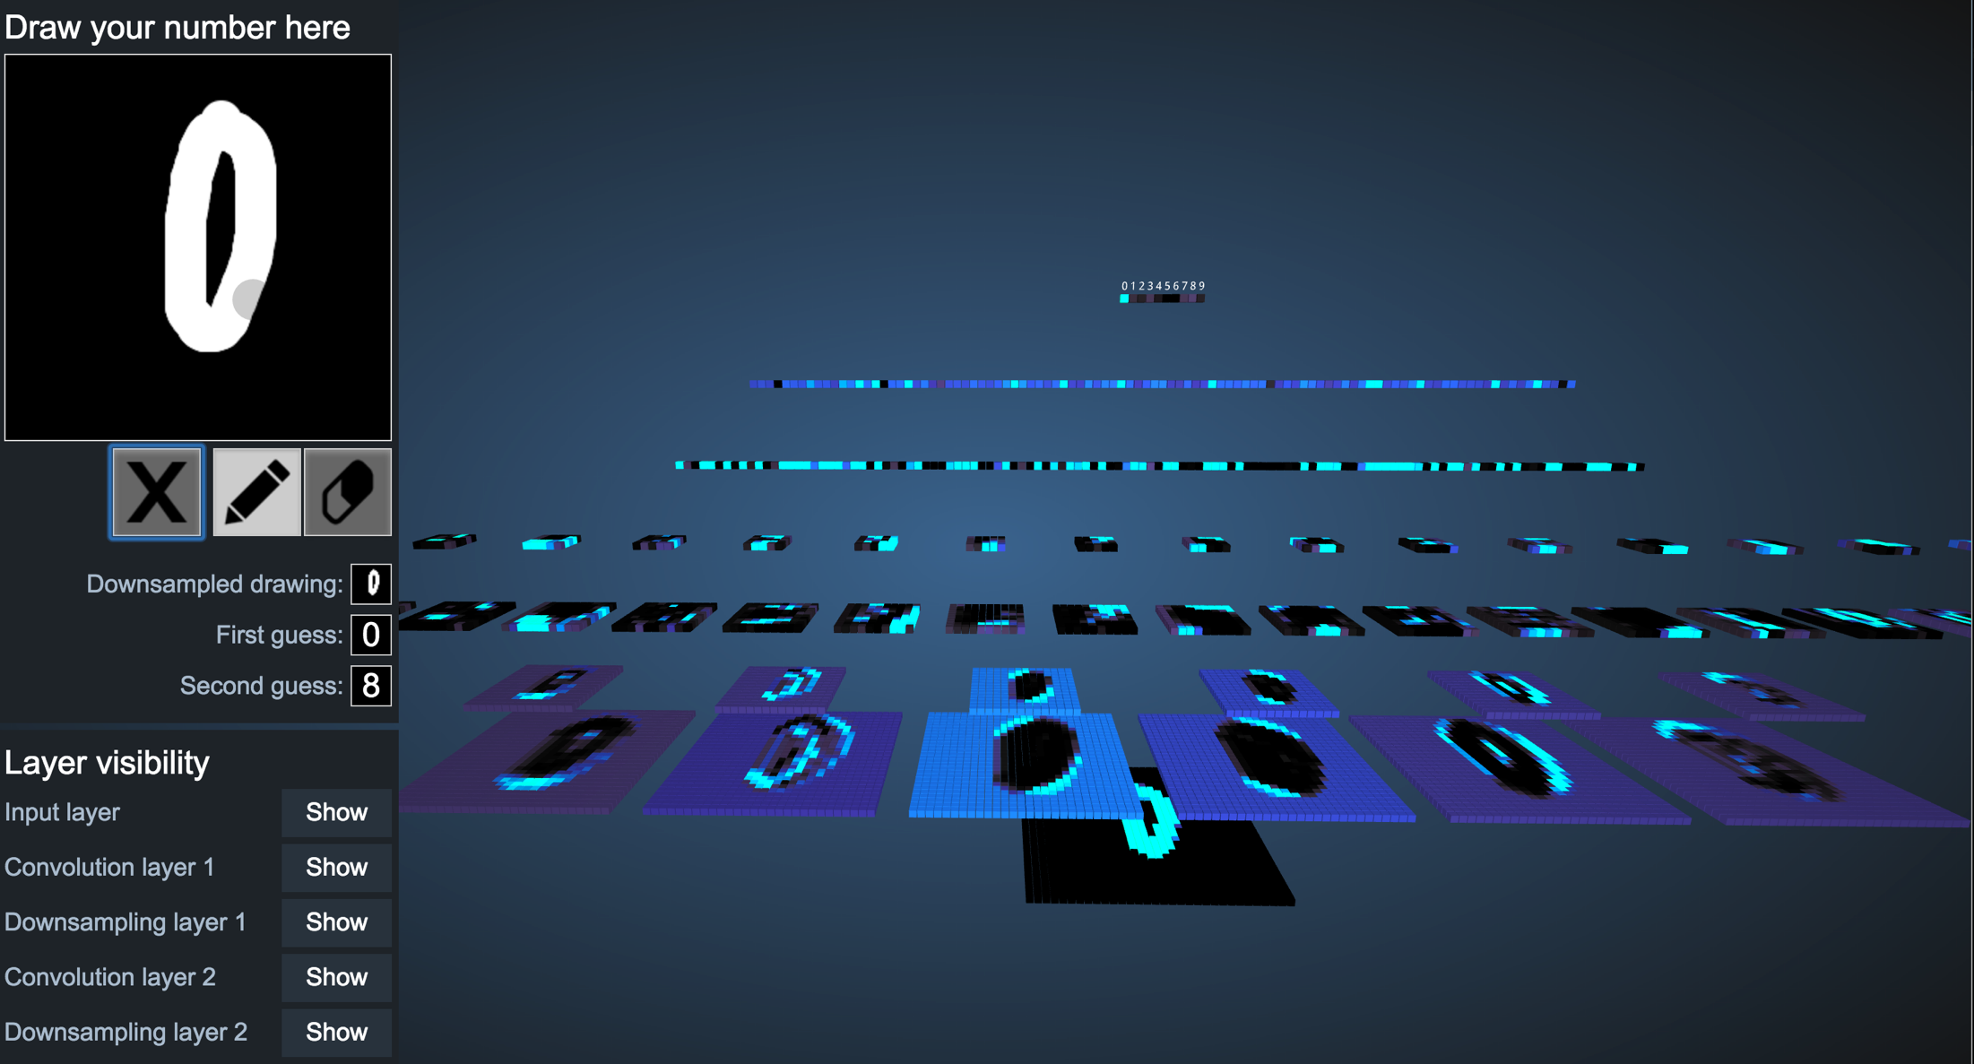
Demonstration
http://scs.ryerson.ca/~aharley/vis/conv/

Slide 69
Great Idea: Artificial Neurons

Slide 70
Neural Networks get their intelligence from their sliders (parameters)

Slide 71
Two Great Ideas
1. Artificial Neurons
2. Learn by Example

Slide 72
Two Great Ideas
1. Artificial Neurons
2. Learn by Example

Slide 73
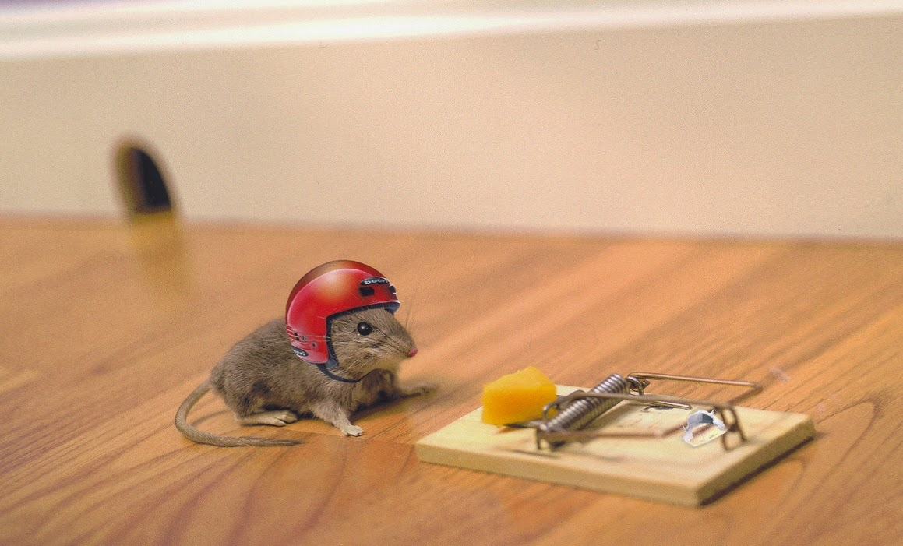
2. Learn From Experience

Slide 74

Learn by Example

Slide 75
+

Slide 76
+

Slide 77
I think that is a picture of a One!
+
What do you mean it’s actually a Zero?
I’ll adjust my sliders so that I do a better job in the future

Slide 78
I think that is a picture of a One!
+
What do you mean it’s actually a Zero?
I’ll adjust my sliders so that I do a better job in the future

Slide 79
+

Slide 80
+

Slide 81
+

Slide 82
I think that is a picture of a One!
+
Wahoo I got it right!

Slide 83
+

Slide 84
+

Slide 85
I think that is a picture of a zero!
+
What do you mean it’s actually a one?
I’ll adjust my sliders so that I do a better job in the future

Slide 86
I think that is a picture of a zero!
+
What do you mean it’s actually a one?
I’ll adjust my sliders so that I do a better job in the future

Slide 87
Study Hard!

Slide 88
Train on Faces

Slide 89
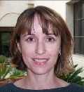
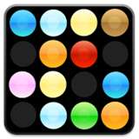
Visualize the Sliders
object models
object parts
(combination
of edges)
Training set: Aligned
images of faces.
edges
pixels
[Honglak Lee]

Slide 90
Woah… that’s like a brain…

Slide 91
True.

Slide 92
Decomposition
Mountain Karel
Climb Up Mountain
Step Up
Pick Beeper
Climb Down Mountain
Step Down
Notes:
He looks like an old machintosh machine.
Hes got legs… one sticks out the back. That’s just the way it is.

Slide 93
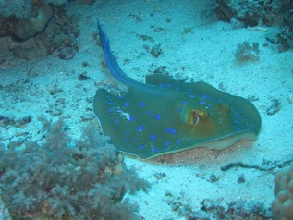
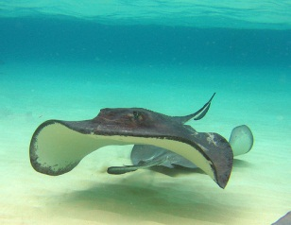
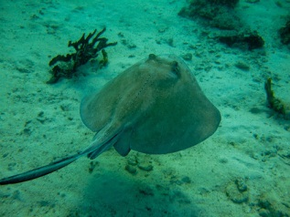
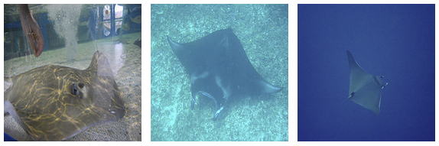
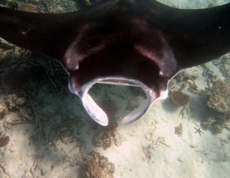
Image Net Classification
…
smoothhound, smoothhound shark, Mustelus mustelus
American smooth dogfish, Mustelus canis
Florida smoothhound, Mustelus norrisi
whitetip shark, reef whitetip shark, Triaenodon obseus
Atlantic spiny dogfish, Squalus acanthias
Pacific spiny dogfish, Squalus suckleyi
hammerhead, hammerhead shark
smooth hammerhead, Sphyrna zygaena
smalleye hammerhead, Sphyrna tudes
shovelhead, bonnethead, bonnet shark, Sphyrna tiburo
angel shark, angelfish, Squatina squatina, monkfish
electric ray, crampfish, numbfish, torpedo
smalltooth sawfish, Pristis pectinatus
guitarfish
roughtail stingray, Dasyatis centroura
butterfly ray
eagle ray
spotted eagle ray, spotted ray, Aetobatus narinari
cownose ray, cow-nosed ray, Rhinoptera bonasus
manta, manta ray, devilfish
Atlantic manta, Manta birostris
devil ray, Mobula hypostoma
grey skate, gray skate, Raja batis
little skate, Raja erinacea
…
Stingray
Mantaray

Slide 94
0.005%
1.5%
?
Random guess
Pre Neural Networks
GoogLeNet
Le, et al., Building high-level features using large-scale unsupervised learning. ICML 2012

Slide 95
0.005%
1.5%
43.9%
Random guess
Pre Neural Networks
GoogLeNet
Szegedy et al, Going Deeper With Convolutions, CVPR 2015

Slide 96
0.005%
1.5%
66.3%
Random guess
Pre Neural Networks
2016
http://image-net.org/challenges/LSVRC/2016/results

Slide 98

Google Brain

Slide 99
Google Brain
1 Trillion Artificial Neurons

Slide 100
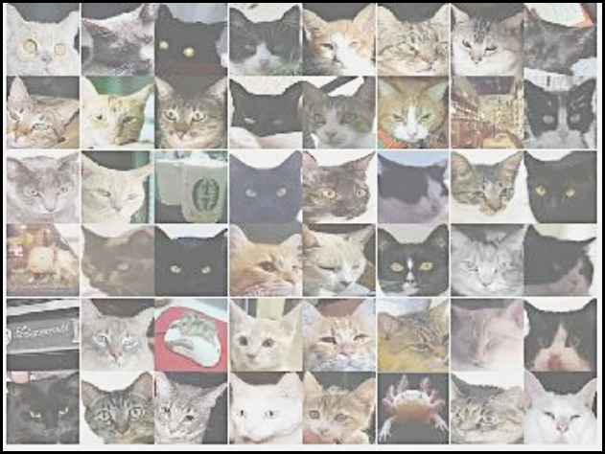
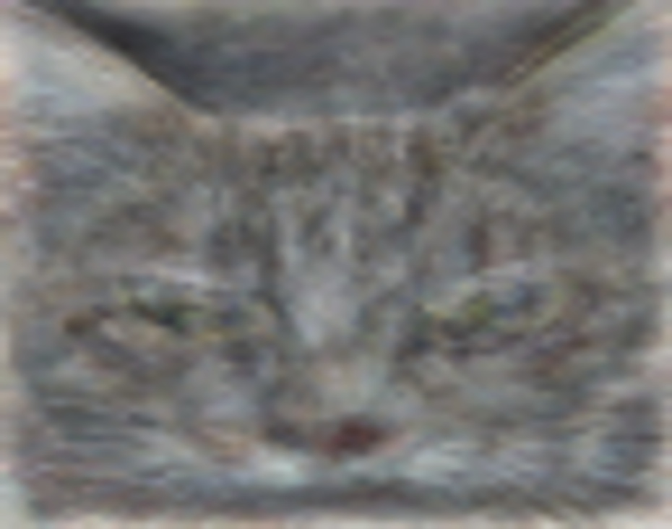
A Neuron That Fires When It Sees Cats
Top stimuli from the test set
Optimal stimulus
by numerical optimization
Le, et al., Building high-level features using large-scale unsupervised learning. ICML 2012

Slide 102
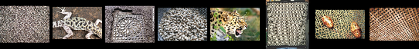
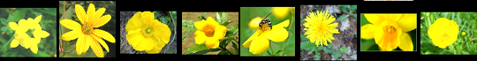

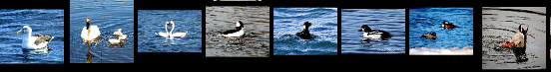

Other Neurons
Neuron 1
Neuron 2
Neuron 3
Neuron 4
Neuron 5
Le, et al., Building high-level features using large-scale unsupervised learning. ICML 2012
Input to another layer above
(image with 8 channels)
Number of output
channels = 8
LCN Size = 5
H
Pooling Size = 5
Number
of maps = 8
One layer
W
RF size = 18
Number of input
channels = 3
Image Size = 200

Slide 103
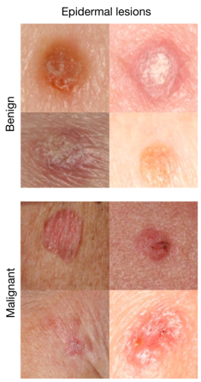
It can be useful
An algorithm learned to detect skin cancer from photo, better than the worlds top expert.
Developed last year
Esteva, Andre, et al. "Dermatologist-level classification of skin cancer with deep neural networks." Nature 542.7639 (2017): 115-118.
Esteva et al., Nature 2017.

Slide 104
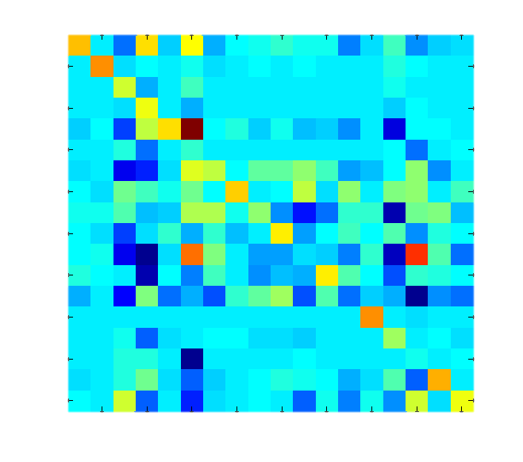
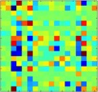
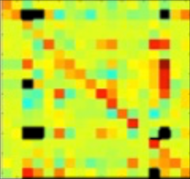
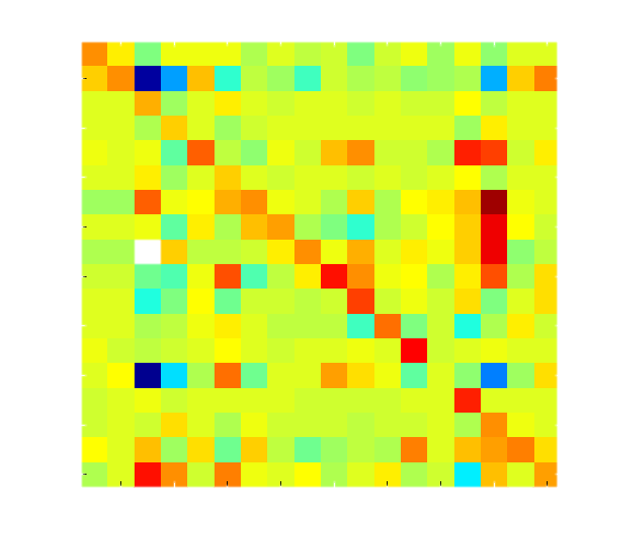
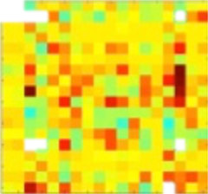
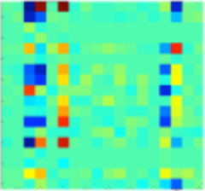

Helping Students Learn to Program
It looks like you have a fencepost error!
// User defined method
private void run() {
while(isClear()){
putBeeper();
move();
}
putBeeper();
}
run
while
putBeeper
cond
body
putBeeper
move

Slide 105
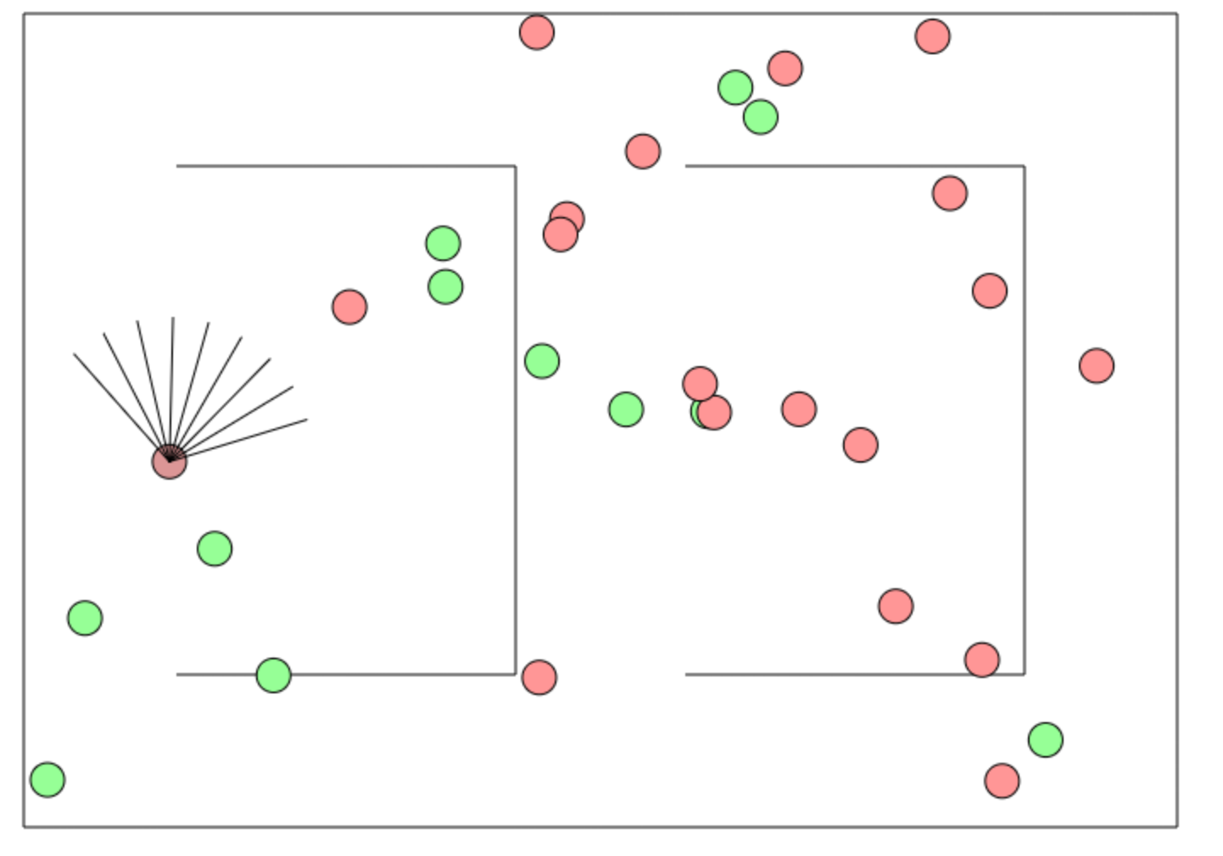
Beyond Harry Potter Hats
http://cs.stanford.edu/people/karpathy/convnetjs/demo/rldemo.html

Slide 106
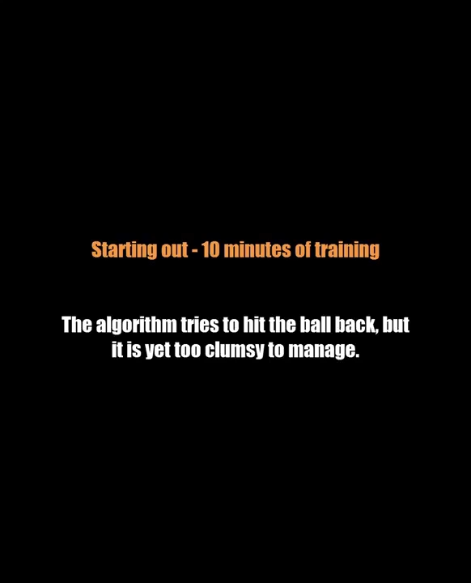
más allá de la clasificación

Slide 107
The Future of AI
Human Intelligence
Performance
Complex Programs
Neural Networks
Time
Now
2012
Notes:
NVIDIA or ATI will be future of AI. Probably NVIDIA.

Slide 108
The Future of AI
Human Intelligence
Performance
Complex Programs
Neural Networks
Time
Now
2012
Notes:
NVIDIA or ATI will be future of AI. Probably NVIDIA.

Slide 109
The Future of AI
Human Intelligence
Performance
Complex Programs
Neural Networks
Time
Now
2012
Notes:
NVIDIA or ATI will be future of AI. Probably NVIDIA.

Slide 110
The Future of AI
Einstein
Human Intelligence
Performance
Complex Programs
Neural Networks
Time
Now
2012
Notes:
NVIDIA or ATI will be future of AI. Probably NVIDIA.

Slide 111
Open Problems?

Slide 112
Machine Learning Uses a Lot of Data

Slide 113
One Shot Learning
Single training example:
Test set:

Slide 114
One Shot Learning
Single
training
example:

Slide 115
Where is my robot?

Slide 116
… coming soon

Slide 117
Should I study AI?

Slide 118

Powerful technology

Slide 119
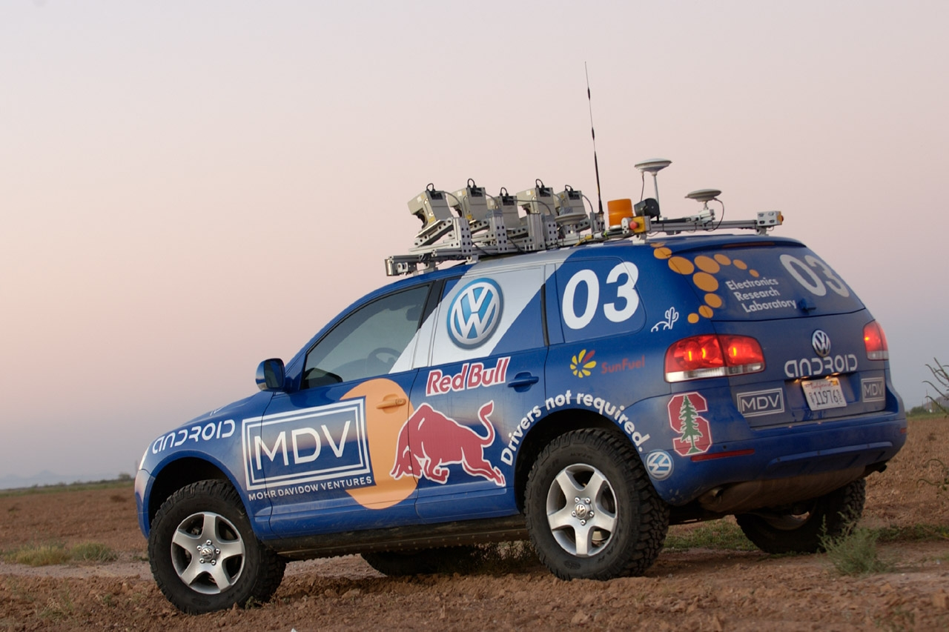
Now is an amazing time

Slide 120

Know It So You Can Beat It
Little math

Slide 121
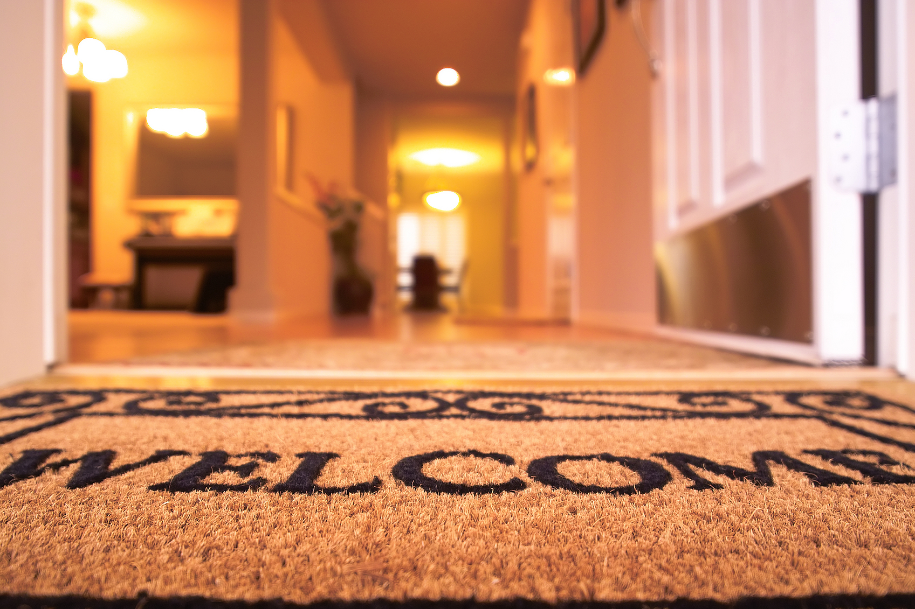
Todos son bienvenidos

Slide 122
Road towards AI
Libraries to use AI
Mathematics to invent AI

Slide 123
Next Step:
…

Slide 125
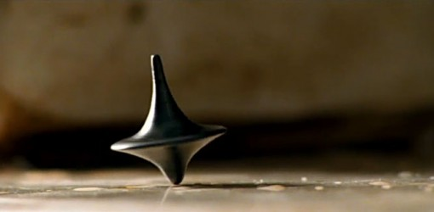
The End?

